Slide 1

Data Driven Education
Discussion Forum Subteam
Presentation 1 - 9/23/2020

Slide 2
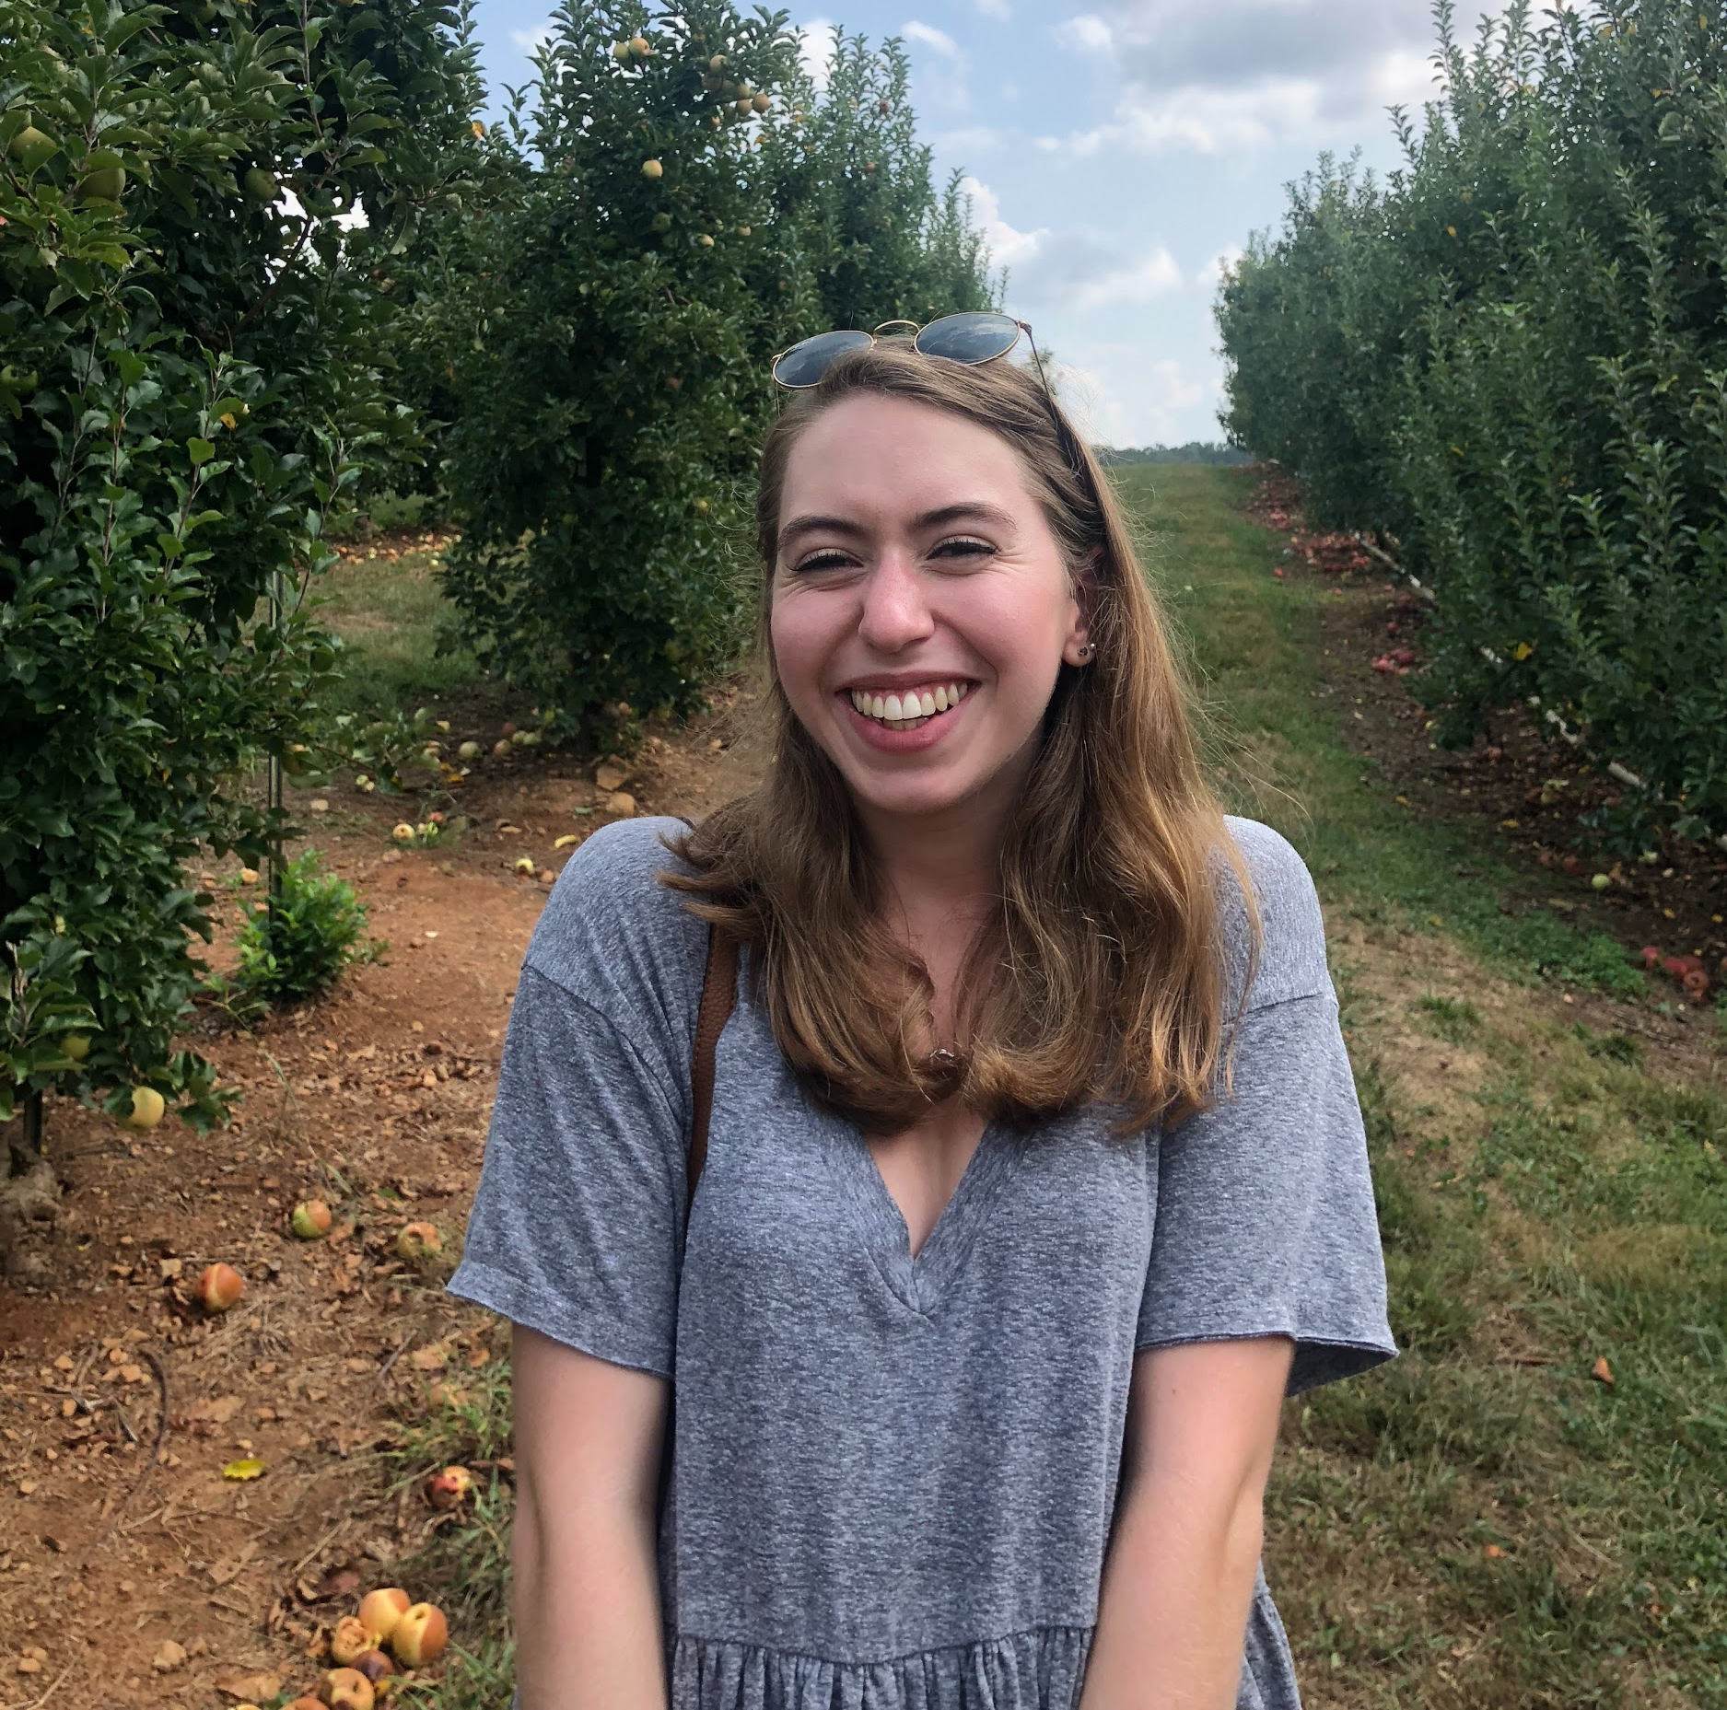
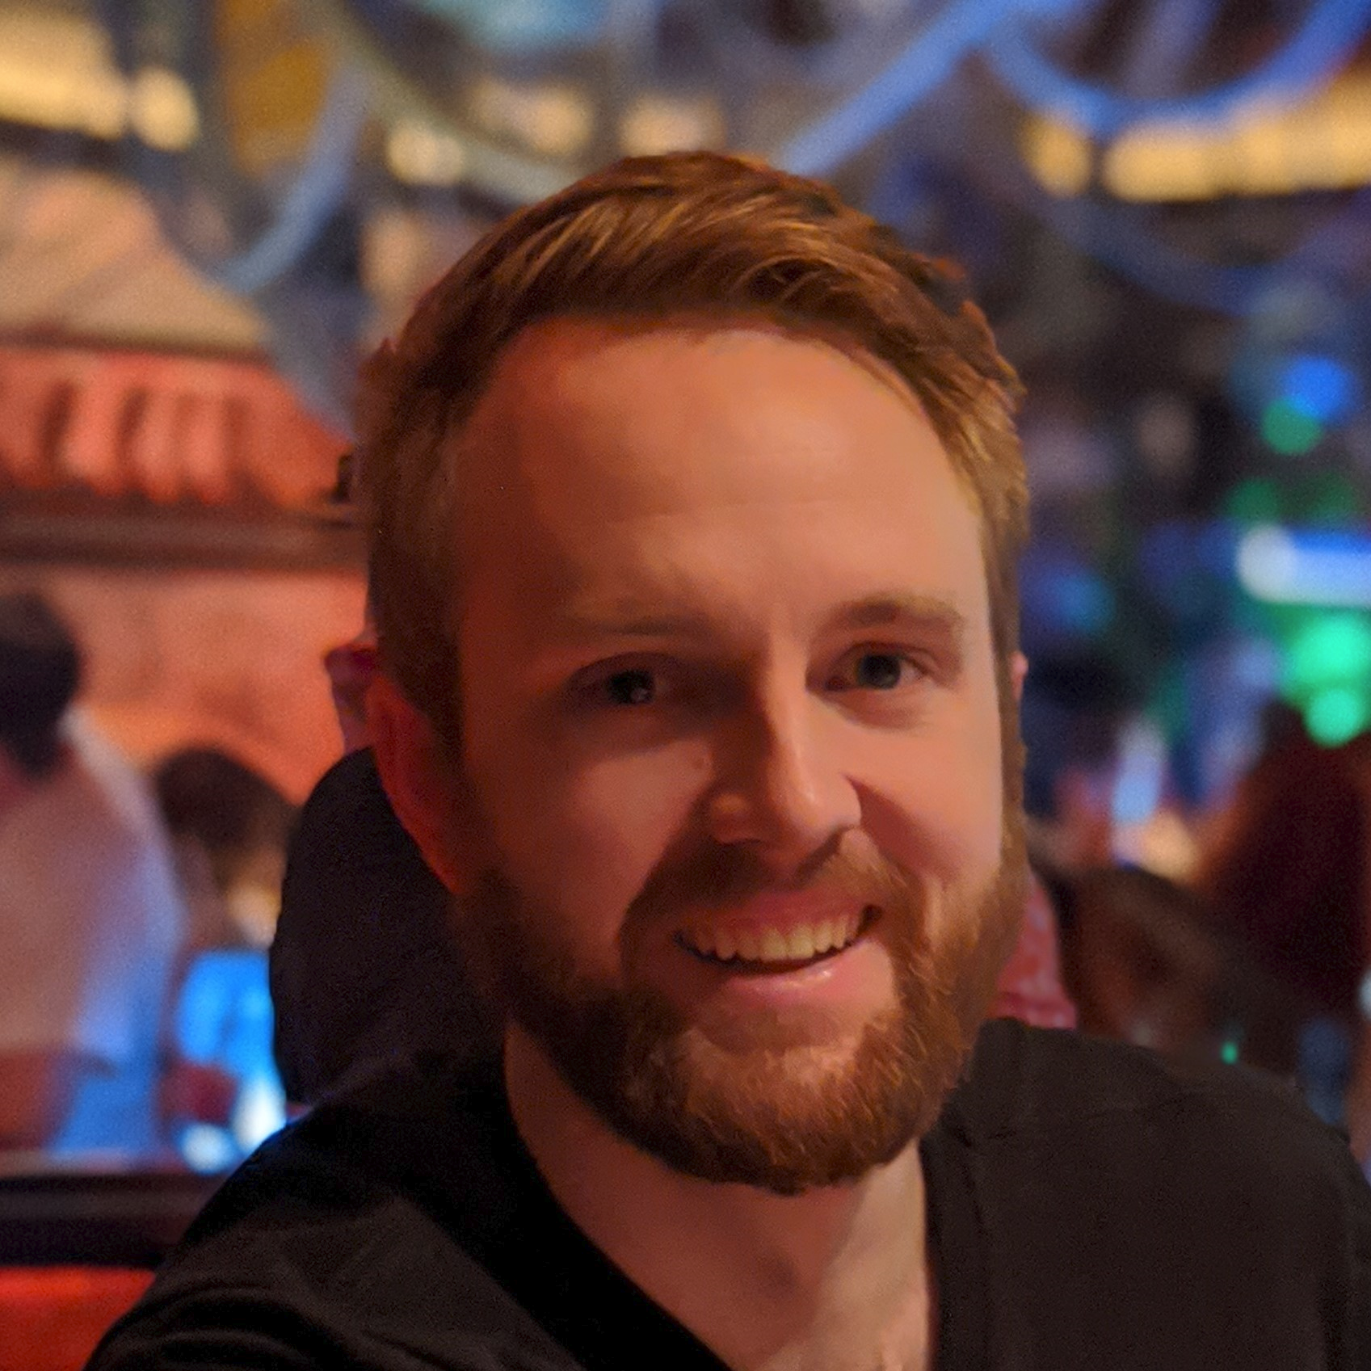
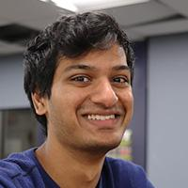
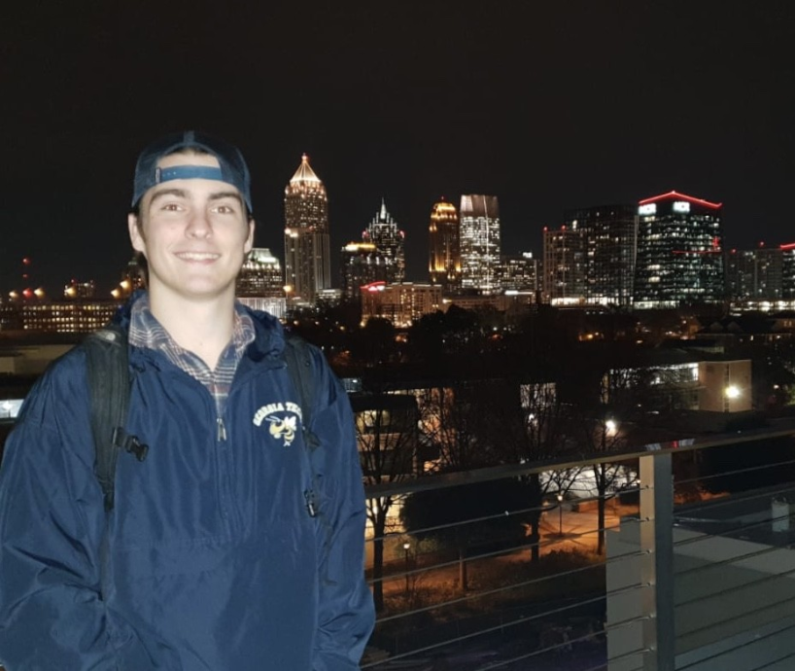
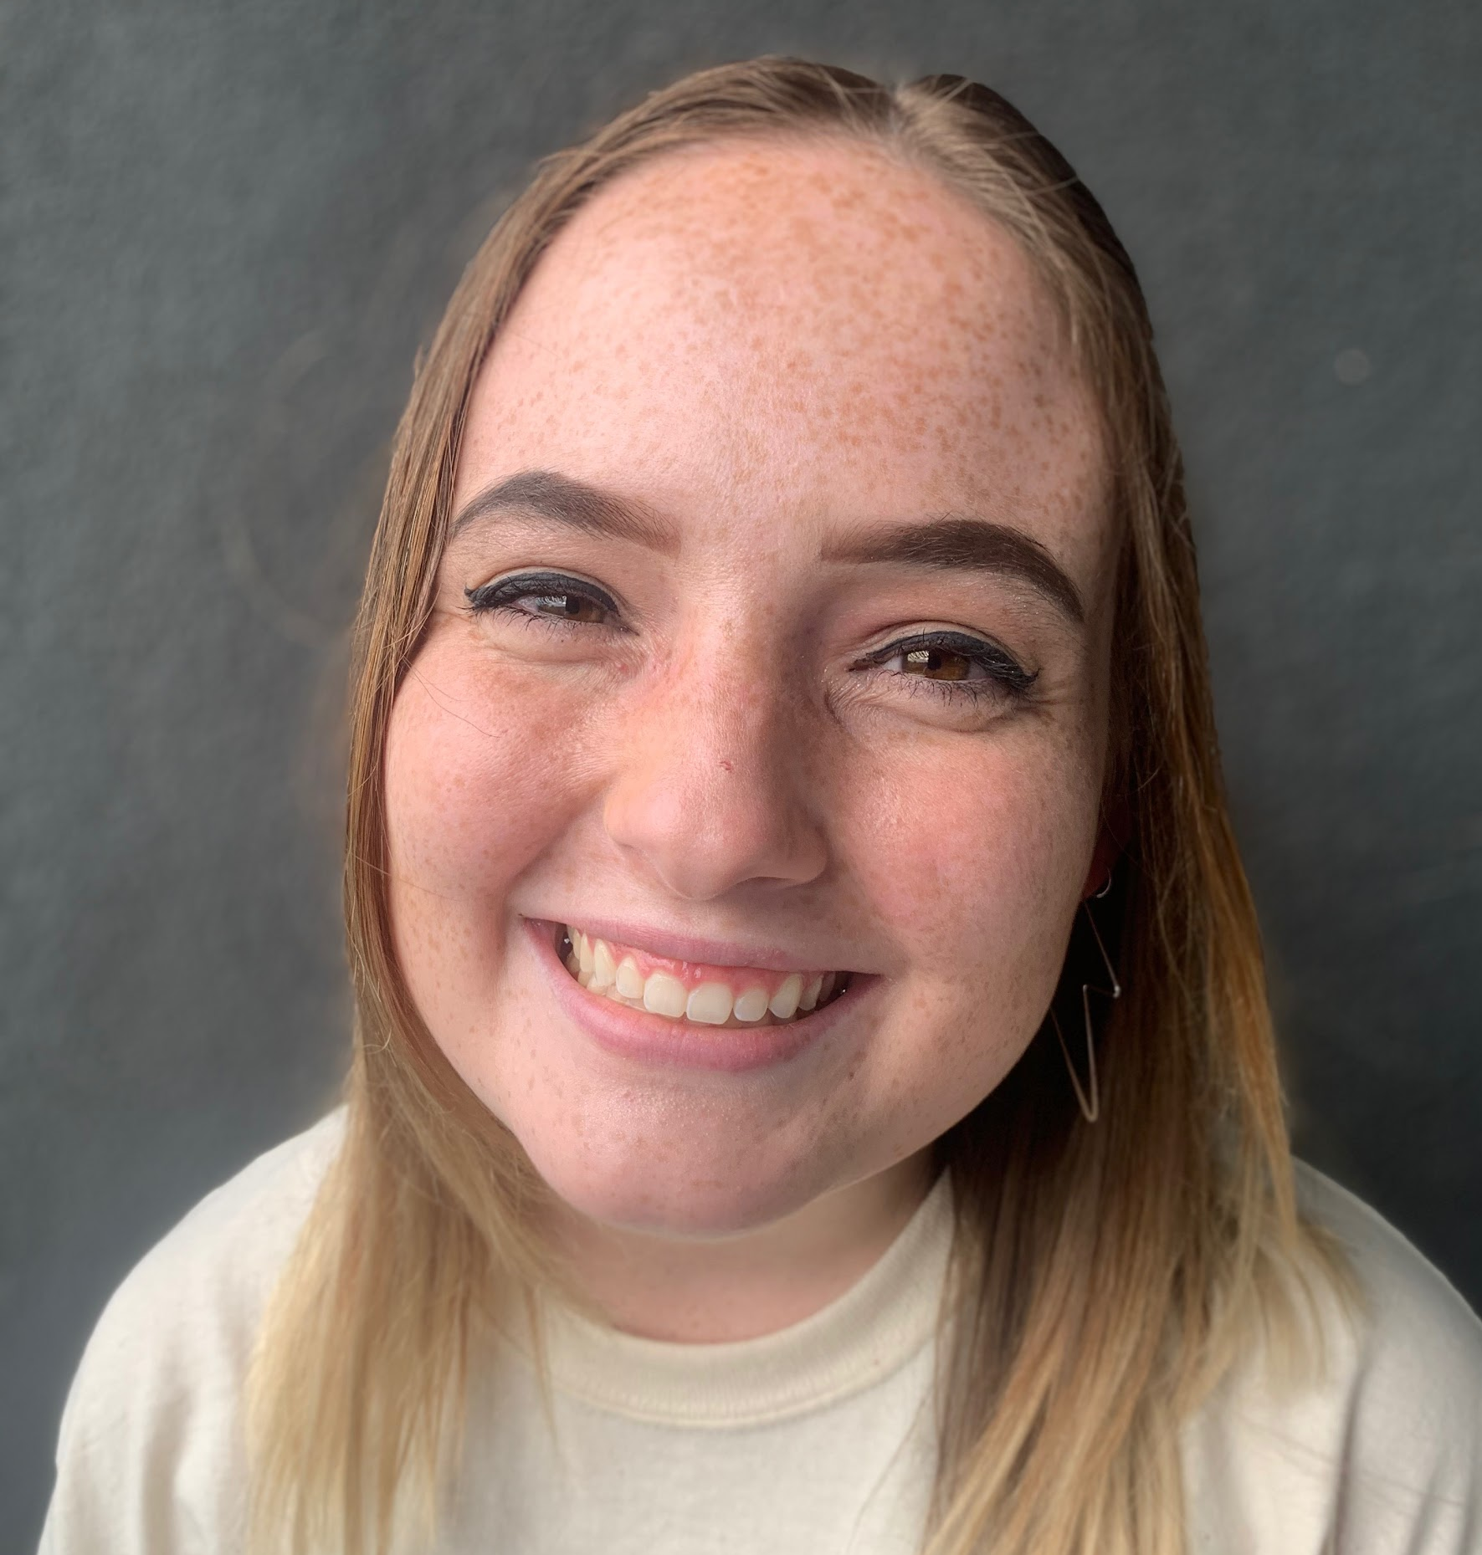
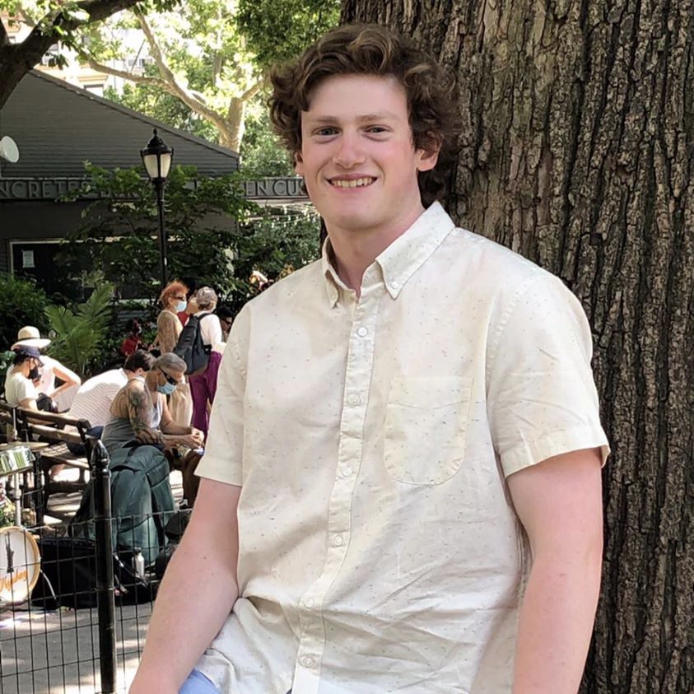
Team Members
Andrew Bauer
Data Scientist
Lindsey Blackmore
Project Manager
Web Developer
John Hosmer
Data Scientist
Sambhav Jaideep
Web Developer
Manny Jonson
Data Scientist
Morgan Powers
Project Manager
Web Developer
Notes:
All

Slide 3
Recap of Data Analysis (Spring 2020)
Shifted focus from Piazza data to edX data
Began work on cognitive presence
  4 phases (triggering event, exploration, integration, resolution)
  Created a document on categorizing cognitive presence
  Manually labeled 500+ comments for model training
Performed basic NLP analysis on the different phrases and organized results in tables and word clouds

Slide 4
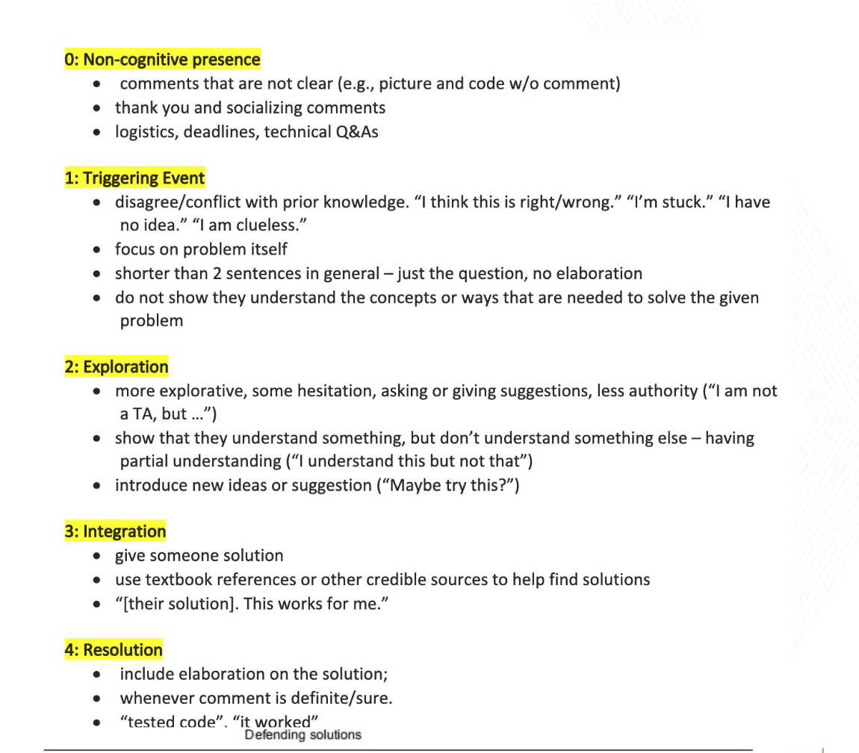
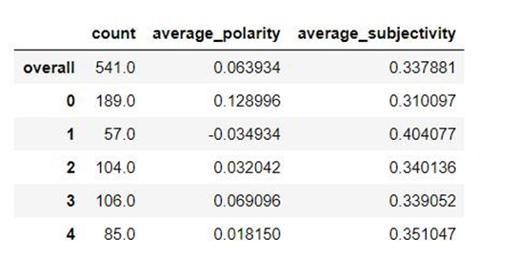
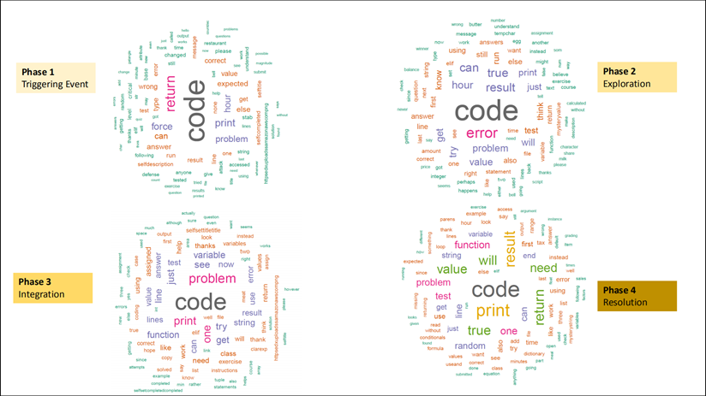

Slide 5
Recap of Web Application Development (Spring 2020)
Designed UI mockups and received feedback on the preferred flow for the web application
Developed a barebones web application that provides a tabular view of discussions from the Canvas sandbox course and the corresponding sentiment and polarity scores
Created a unified design document

Slide 6
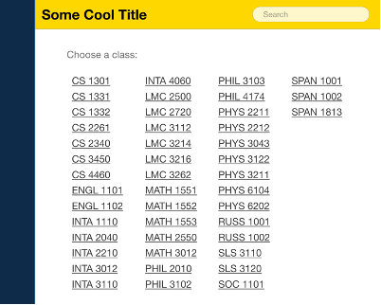
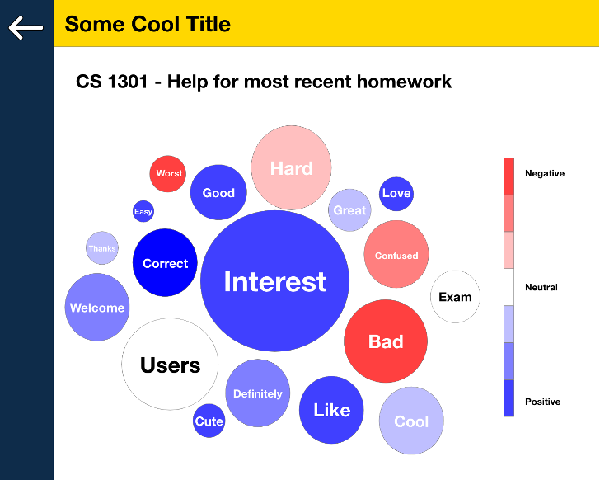
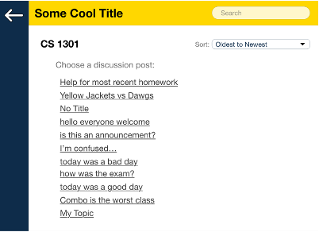
Recap of Web Application Development (Spring 2020)

Slide 7
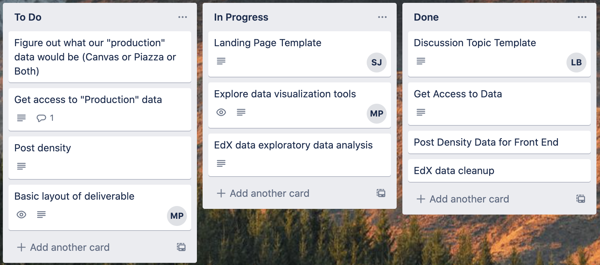
Takeaways
Better communication and integration among the subteams
More understanding of all the resources available
Utilize Trello

Slide 8
Data Science Team
With so many possible things for the team to work on, we will need to fail fast on anything that we can’t or don’t think we can complete
Allow team members to explore early in the semester and then focus on delivering data and insight pipelines by the end of the semester
If anyone has any ideas for how forum data could be used, we would love to hear it

Slide 9
Goals on Data Science
Done: Provide post density data
Current priorities:
  End-to-end model predicting cognitive presence value from test
  Provide polarity and subjectivity values to front end team
Backlog:
  Predict posts which will require TA or professor intervention
  Enhance keyword search
  Analyze student engagement
  Topic modeling of posts

Slide 10
Web Application Development Team
Created templates for the modular version of the web app
Integrated React components
Shifting data source from Canvas to edX
Began exploring options for basic metrics to display

Slide 11
Goals on Web Development
Incorporate edX data into the existing web app
Create a few simple data visualizations
Determine the best practice to integrate cognitive presence
Continue documentation in the design document

Slide 12
Questions?

